Slide 1
Module 1
Project management
Part 8

Slide 2



Standard - an official document, which describes the established norms, methods, processes and practices.

Slide 3
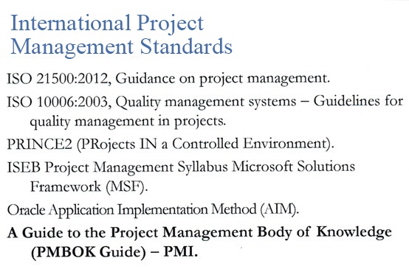

Slide 4
National Project
Management Standards
USA – NASA Project Management.
Great Britain – APM Body of Knowledge (Association for Project Management).
Germany – DIN 69901 (Deutschen Instituts für Normung).
France – AFITEP (Association Francophone de Management de Projet).
Switzerland, Australia, Canada, Japan, China, South Africa, India, South Korea.
Russia - REQUIREMENTS FOR PREJECT MANAGEMENT. GOST R - 54869

Slide 5
National standard of the
Russian Federation
Project Management.
REQUIREMENTS FOR PROJECT MANAGEMENT. GOST R - 54869
REQUIREMENTS FOR PORTFOLIO MANAGEMENT. GOST R - 54870
REQUIREMENTS FOR PROGRAM MANAGEMENT. GOST R - 54871
Official publication

Slide 6
Existing project management standards based on the assessment of the competence of the project manager
Russia – ICB IPMA Competence Baseline (IPMA).
USA – PMCDF (Project manager Competency Development Framework)

Slide 7
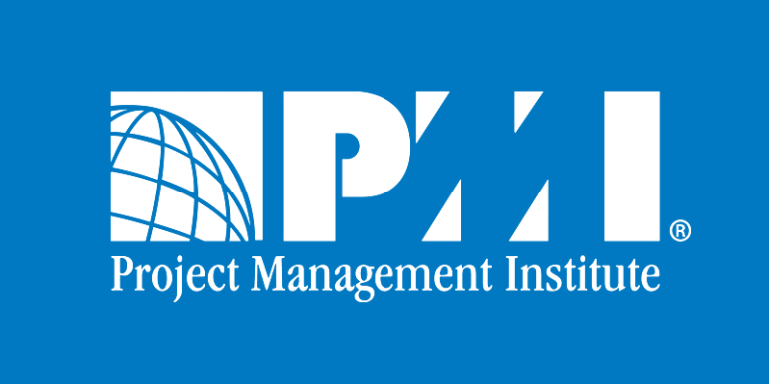

Slide 8
PMI
Project Management Institute
PMBOK Guide
1987
1996 – 1 edition
2000 – 2 edition
2004 – 3 edition
2008 – 4 edition
2013 – 5 edition

Slide 9
PMI standards
Basic standards.
A Guide to the Project Management Body of Knowledge (PMBOK Guide) – Fifth edition.
Organization project Management Maturity Model (OPM3) – Second Edition.
The Standard for Portfolio Management – Third Edition.
The Standard for Program Management – Third Edition.

Slide 10
Practical standards
Practice Standard for Project Risk Management.
Practice Standard for Project Configuration Management.
Practice Standard for Scheduling – Second Edition.
Practice Standard for Earned Value Management – Second Edition.
Practice Standard for Work Breakdown Structures – Second Edition (Reaffirmed).
Practice Standard for Estimating
Practice Manager Competency Development Framework – Second Edition.

Slide 11
Additions to standards
Construction Extension to the PMBOK Guide – Third Edition
Government Extension to the PMBOK Guide – Third Edition

Slide 12
Project Management Certification
№ | Status | For whom?
1 | Certified Associate in Project Management(CAMP). | For beginners in a project management career
2 | Project Management Professional (PMP). | Most requested and recognized status for project managers
3 | Program Management Professional (PgMP). | For those who manage complex projects, combined to achieve strategic goals
4 | PMI Agile Certified Practitioner (PMI-ACP)SM. | For those who apply Agile approaches (flexible management of prectomy)
5 | PMI Risk Management Professional (PMI-RMP). | For those who have demonstrated competence in assessing project risks, reducing threats and increasing opportunities
6 | PMI Scheduling Professional (PMI-SP). | For those who develop and manage project schedules
7 | Portfolio Management Professional (PfMP). | For those who want to confirm their ability to manage and coordinate projects and programs within the portfolio in order to implement the strategy and objectives of the company

Slide 13
Requirements
Status | Basic education | Work experience | Project Management Training | Certification cycle
Certified Project Management Specialist | Secondary education | 1500 hours | 23 hours | 5 years without PDU
Project Management Professional | Secondary education Higher education | 7500 hours 4500 hours | 35 hours | 60 PDU for 3 years
Program Management Professional | Secondary education Higher education | 10500 hours 6000 hours | - | 60 PDU for 3 years
Certified Practice for Flexible Project Management | Secondary education | 2000(standart)+ 1500(flexible) | 21 hours | 30 PDU for 3 years
Risk management professional | Secondary education Higher education | 4500 hours 3000 hours | 30 hours | 30 PDU for 3 years
Schedule Management Professional | Secondary education Higher education | 5000 hours 3500 hours | 30 hours | 30 PDU for 3 years
Portfolio Management Professional | Secondary education Higher education | 10500 hours 6000 hours

Slide 14
List of recommended literature
Guide to the body of knowledge on project management. (Guide PMBOK Guide) / lane. from English; 4th ed. - РМI, 2008.
A Guide to the Project Management Body of Knowledge. Fifth Edition. 2013 - PMI, Inc. Four Campus Boulevard, Newton Square, PA 19073-3299 USA.
Diethelm Gerd. Project management: in 2 tt / lane. with him. - SPb .: Ed. House "Business and Law", 2003. - Vol. 1: The Basics. - 389 s.
Drucker Peter. Management Practice / Per. from English - M .: Publishing house "Williams", 2003. - 397 p.
Heldman Kim. Professional project management / trans. from English - M .: BINOM. Laboratory of knowledge, 2012.

Slide 15
THANKS FOR ATTENTION!!!

